Slide 1
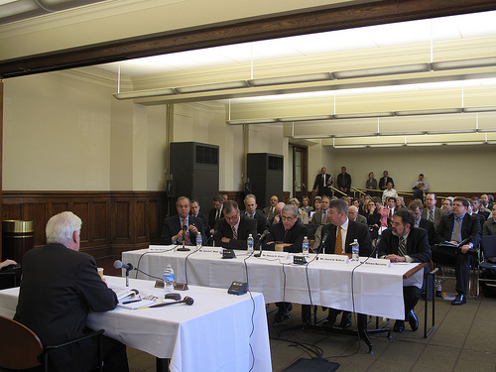
THE COMMITTEE SYSTEM
I. Intro.
A. Real work of Cong. is done in committees and subcommittees, not on the floor of the
House or Senate.
B. Before a bill even reaches the floor, it must first pass through a committee, unless the
committee has resisted "reporting out" the bill and the House votes to "discharge" it onto the
floor for consideration by the full body. (Senate committees lack the power to prevent bills from reaching the floor).
Committee functions:
1. Analyze legislation.
2. Conduct investigations of executive branch on as-needed basis.
3. Conduct oversight of executive branch agencies on an ongoing basis.
A Congressional Committee in Session

Slide 2
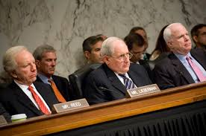
Selection of Committee Chairmen
A. Power of chairmen is substantial over:
1. Setting committee agenda.
2. Hiring staff.
3. Membership on subcommittees.
4. Jurisdiction of subcommittees.
B. Chairmen are selected by secret ballot in party caucuses or conferences (of party leaders) at the beginning of the term. Generally, the seniority system is followed, i.e., the person of the majority party with the most seniority on that committee is chosen chairman. The 104th Congress imposed term limits of 6 years for both House and Senate chairmen. This took effect starting in 2001, and was one of the Gingrich reforms.

Slide 3

Selection of Committee Chairmen
C. Advantages of seniority system:
1. Experience.
2. Stability.
3. Expertise.
4. Reduces infighting among those who would be rivals for chairmen.
D. Disadvantages of seniority system: Increases influence of 1 party states, and decreases influence of competitive states.
E. “Ranking member:” most senior member of minority party on a committee

Slide 4
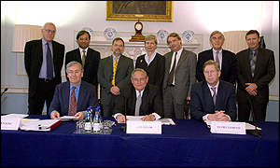
Selection of Committee Members
A. Importance of getting on the right committee, i.e., one in which a member can best serve his constituents, and thus increase his/her chances of reelection.
B. Members are assigned to committees by either the Committee on Committees (Rep.) or the Steering and Policy Committee (Dem.).
C. Whichever party has a majority in the house will have a majority on each committee.
D. Committee chairman is of majority party, ranking member is of minority party.

Slide 5

Important Committees
Standing
committees are the
permanent committees of
Congress. They have
legislative, investigative,
and oversight powers

Slide 6
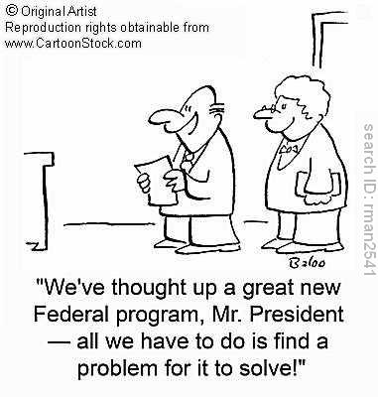
Types of Standing Committees
A. Types of standing committees:
1. Authorizing: allow for creation of fed. programs
2. Appropriations: provide funding for fed. programs
3. Revenue and budget: raise money for fed. programs

Slide 7

House
1. Rules: most powerful of all. Sets legislative calendar and establishes "rules" for debate and amendments.
2. Ways and Means: deals with tax bills.
3. Appropriations: deals with spending bills.
a. Authorization bill allows for money to be spent, and appropriation bill provides the actual funding for the program.
b. “Earmarks:” special projects set aside by members to benefit home districts or states. Dramatic rise of these in recent years.

Slide 8
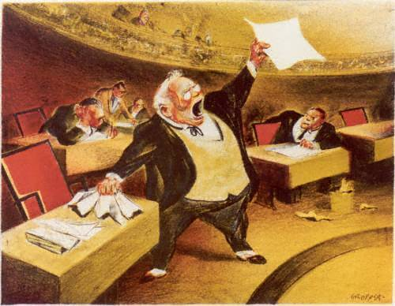
Senate
1. Finance: deals with tax bills.
2. Appropriations: deals with spending bills.
3. Foreign Relations. Highly prestigious. Senate has larger role in foreign affairs than House because of treaty ratification and ambassador confirmation provisions in Const.
4. Judiciary: Screens judicial nominees. Careful scrutiny given because of the power of the modern judiciary and the fact that judges have life terms. Presidents Clinton and Bush 43 both criticized the committee by holding up numerous judicial nominations. Some delays under Clinton lasted many months, and in some cases, years. The current Congress is still holding up Obama’s most current Supreme Court nomination.

Slide 9
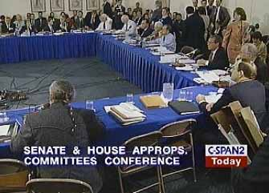
Conference Committees
A. Temporary committees comprised of members from both houses.
B. Develop compromise language on a bill when House and Senate versions differ (about 10% of the time).
C. After conference committee sends bill back to each house, no amendments are allowed,
and the bill generally passes.
D. The power of these committees is such that they are often called the "third house of Congress."

Slide 10
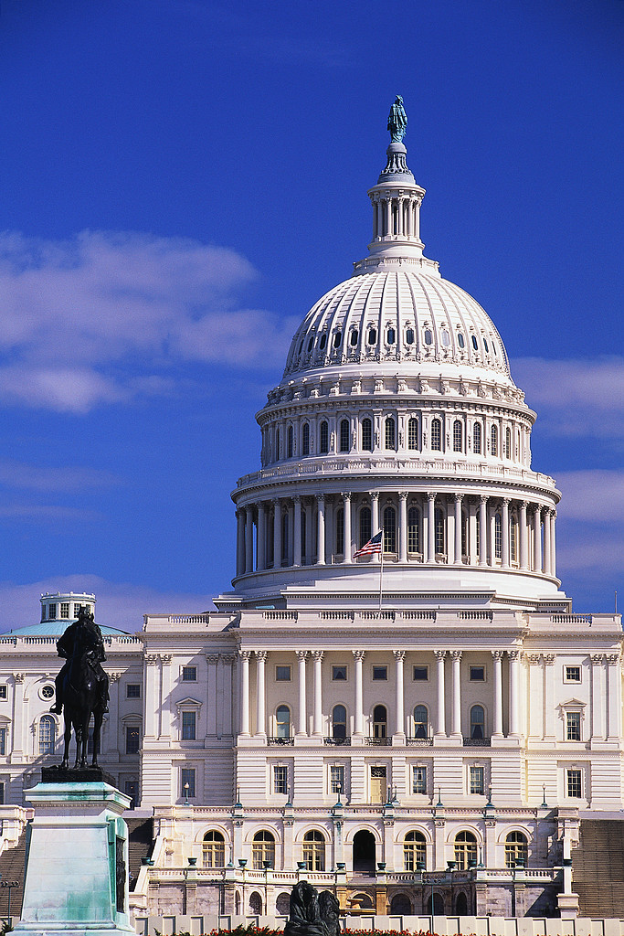
Other Types of Committees
A. Select: appointed by a house for a limited, temporary purpose, e.g., to study an issue or to
conduct an investigation.
B. Joint: composed of members from both houses for similar temporary purposes

