Slide 1
Agenda- 1/26
CE Topic: Constitutional Principles (not Federalism!)
Review DOI Activity
Lecture: Constitutional Principles
Federalist Papers Activity
HW: Fed Papers, Constitution Scavenger Hunt, Constitution Quiz Friday

Slide 2
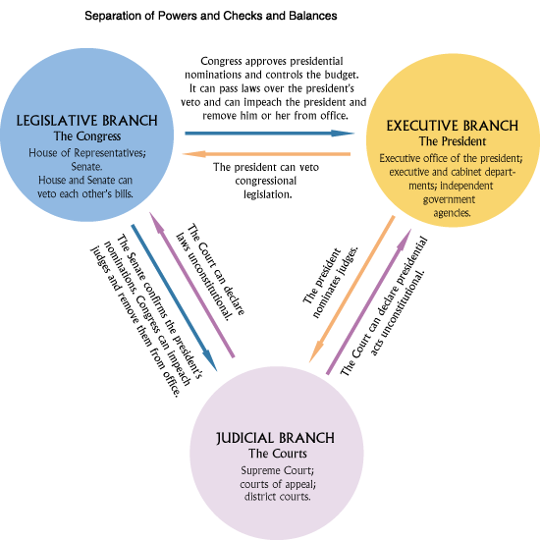
I. Separation of Powers
I. Separation of powers.
A. To Madison, tyranny was govt. that controlled all 3
branches of govt. ---> Division of power among the legislative, executive, and judicial branches.
B. This system diffuses power instead of concentrating
power.
C. Influence of Montesquieu.
D. Colonial experiences, e.g., excessive power in st. legislatures → need for strong exec.
E. Danger of one branch combining forces with another
branch ---> checks and balances.

Slide 3
II. Checks and Balances
A. Background.
1. 18th century view of govt. as something to be restrained, and modern view of govt. as something to be used for the common good.
Fear of tyranny among Founders ---> distrust of govt. ---> checks and balances as means of intentionally building inefficiency in order to prevent govt. abuse of power.
B. System of restraints in which each branch can check the other two. Reflects fear of tyranny.
C. Examples: veto, veto override, appointment and confirmation, treaty-making and ratification, defense funding and Commander-In-Chief.
D. Political independence within each branch: no branch is dependent upon the other two for election (exception: judges are appt'd by President) and continuance in office (life terms for judges ameliorate presidential influence).
E. Staggering of terms within each branch -> a majority of voters can gain control over one part of govt. at one time, e.g., midterm cong. elections can serve as a check on the exec.
F. Modifications of checks and balances: examine if the following strengthen or weaken checks and balances.

Slide 4
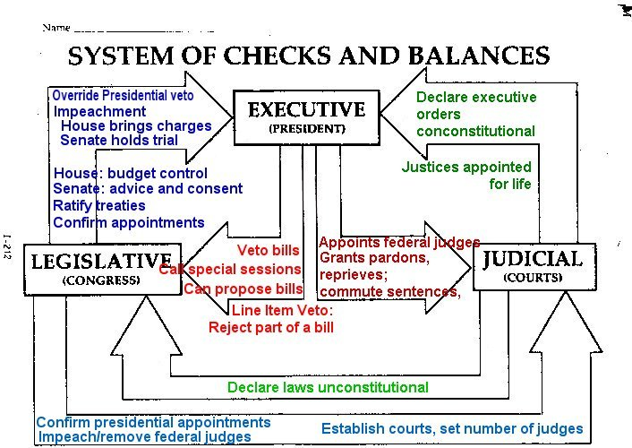
Checks and Balances

Slide 5
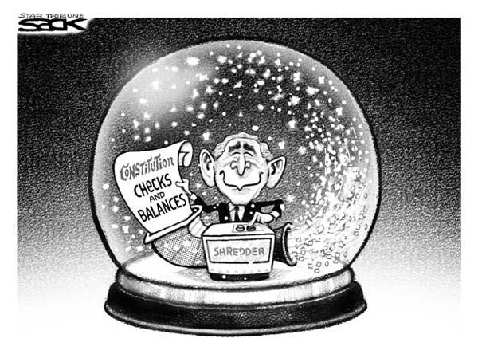
II. Checks and Balances
1. Political parties.
a. In theory, should weaken checks and balances -- a way of bringing the branches of govt. together. Const. divides govt., but parties bring people in govt. together.
b. In reality, however, parties are weak:
Dominance of only 2 parties ---> each party has wide range of interests ---> much disagreement within each party itself ---> difficult to assert such strong control
c. Prevalence of divided govt., i.e., a Pres. of one party and a Cong. of the other.

Slide 6
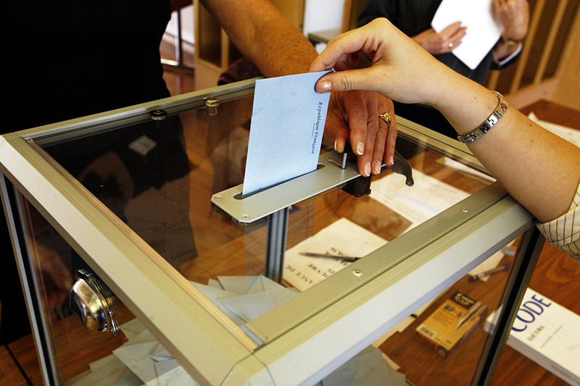
II. Checks and Balances
2. Changes in voting methods.
a. Senators now chosen by people.
b. Congressmen also chosen by people.
c. Presidents chosen by electors who vote as the people have voted.
-- Thus, members of two branches essentially chosen by same electorate ---> weakening of checks and balances in theory; however, split ticket voting has changed this.

Slide 7
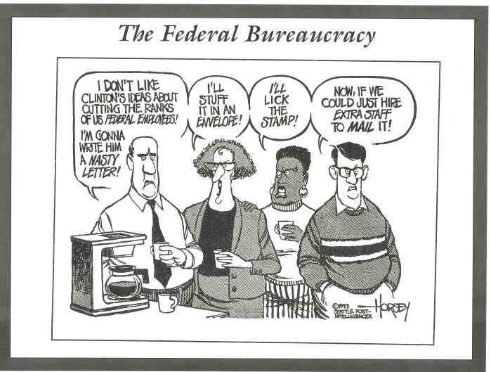
II. Checks and Balances
3. Growth of federal bureaucracy.
a. Development of numerous agencies w/legislative, executive, and judicial functions.
b. Congress often grants broad authority to agencies and lets them carry out the general will of Congress, e.g., Congress established an IRS to collect taxes, and then granted the IRS authority to help write the tax code, enforce the tax code, and settle disputes over the tax code.
-- Thus, growth of bureaucracy has caused a weakening of checks and balances.

Slide 8
II. Checks and Balances
4. Changes in technology, e.g., nukes, computers, fax machines, satellite communications: Two views:
a. President, Congress, interest groups, media have all been able to take advantage of the new technologies ---> strengthening of checks and balances.
b. President has been especially able to take advantage of these ("electronic throne"), e.g., “staged event” of Bush landing on an aircraft carrier ---> weakening of checks and balances.

Slide 9
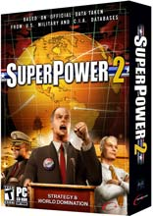
II. Checks and Balances
5. Emergence of U.S. as world power after WWII.
a. Areas of "national interest" extend around the world.
-U.S. is leader of free world.
-U.S. is only remaining superpower after Cold War
b. With such heavy responsibilities, any crisis seems to involve U.S. somehow.
---> These responsibilities need to be dealt with in a strong and efficient manner --->power has concentrated in executive branch ("imperial presidency") ---> weakening of checks and balances.

Slide 10
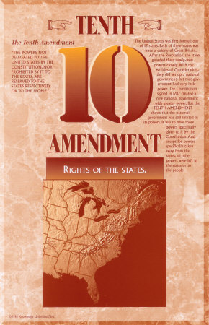
III. Limited Government
Limited government: dilemma of wanting a more effective government, but also a limited government that did not become tyrannical.
A. Constitutional government: govt. has only those powers listed in Const.
B. Bill of Rights as a safeguard against possible tyranny from a new, strong, distant government. Little fear of state govts, but great fear of national govt. Amendment 10 reflects view that states would have substantial powers: central govt. could exercise only those powers delegated to it by the Const. States would have all else.
Free elections, but potential of majority faction ---> Madison's "auxiliary precautions."

Slide 11
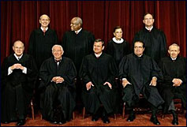
IV. Judicial review.
A. Power of courts to strike down laws or governmental actions.
B Not explicitly provided for in Const., but Const. written in broad terms ---> need for interpretation ---> this most logically falls to the courts.
C. Established by Marbury v. Madison, 1803:
1. Facts of case: the end of Federalist control of govt. and appointment of the "midnight judges," including Marbury ---> Jefferson ordered Madison to not deliver commissions to these judges --->Marbury's request for a writ of mandamus (under Sect. 13 of Jud. Act. of 1789) from the Supreme Court to order the delivery of his commission.
2. Decision of Marshall and the Court: section 13 of Judiciary Act of 1789 enabling the Court to issue a writ of mandamus through original jurisdiction in this type of case was unconstitutional.

Slide 12
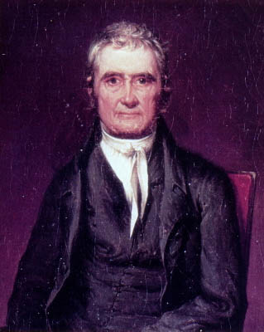
IV. Judicial Review
3. Analysis.
a. Marshall ruled that the Court did not have the authority to issue the writ, but he paradoxically increased its power by establishing judicial review when the Court struck down section 13.
b. Jefferson couldn't complain because the midnight judges didn't receive their appointments, but he fumed because his enemy, Federalist John Marshall, increased the power of the Court.
Effects of judicial review: citizens can challenge constitutionality of laws in court by initiating lawsuits (example: Gideon v. Wainright, 1963) → litigation has become an important way of making public policy.
Chief Justice John Marshall

